Slide 1

DEPARTMENT OF COMPUTER SCIENCE & ENGINEERING
SCHOOL OF COMPUTING
1156CS701- MAJOR PROJECT
IN-HOUSE
WINTER SEMESTER(2023-2024)
REVIEW - II
“PREDICTIVE PAYMENT PLAN USING MACHINE LEARNING”
SUPERVISED BY
Dr. R. KANCHANA
Associate Professor
PRESENTED BY
1. P.V.JITHENDRA YADAV (18354)(20UECS0751)
2. P.S.V.DATTA SAI (16977)(20UECS0765)
3. P.SHIVA NARENDRA (16040)(20UECS0708)

Slide 2
AGENDA
ABSTRACT
OBJECTIVE
INTRODUCTION
LITERATURE REVIEW (SOFT COPY OF PAPERS TO BE LINKED AS HYPERLINK)
DESIGN AND METHODOLOGIES
IMPLEMENTATION
TESTING
INPUT AND OUTPUT
CONCLUSION
REFERENCES

Slide 3
ABSTRACT
Traditional payment patterns have been revolutionized by Buy Now, Pay Later (BNPL), which has become a disruptive force in the retail and e-commerce industry. An extensive synopsis of BNPL is given in this abstract, including its definition, working principles, benefits, drawbacks, and potential future applications.
Buy Now, Pay Later gives customers the option to make purchases right away and spread out their payments over a certain time period often without incurring interest.
In order to provide clients with installment plans or deferred payment options at the point of sale, BNPL partners with retailers. With clear terms and conditions, users can divide their purchases into reasonable installments, usually spread out over a few weeks or months.

Slide 4
OBJECTIVES
Aim of the Project:
Machine learning-enhanced Buy Now Pay Later (BNPL) technologies seek to transform the finance industry. Machine learning makes it possible to make decisions in real time, ensuring effective risk management and fraud prevention by studying a variety of data sources and user behaviour patterns.
Scope of the Project:
A Buy Now, Pay Later (BNPL) initiative's main goal is to transform the conventional payment landscape by giving customers a practical and adaptable substitute.

Slide 5
INTRODUCTION
With the rise of Buy Now, Pay Later (BNPL) as a popular alternative payment option, customers' shopping and money management have changed significantly in recent years. This introduction gives a general overview of the idea of bad debt portfolio lending (BNPL), how it developed, and how important it is becoming to the retail and online industries.
Fundamentally speaking, buy now pay later allows customers to conveniently make purchases.
This payment method offers a flexible and accessible substitute that is appealing to a wide range of customers, in contrast to conventional ways like cash or credit cards.
The emergence of BNPL can be attributed to the combination of evolving customer behaviour, technological advancements, and an increasing need for financial flexibility.
By utilizing digital platforms and data analytics, fintech organizations have introduced novel solutions that optimize the buying process and enable customers to more skill fully manage their budgets.

Slide 6
LITERATURE REVIEW
1. Chernovita Hanna Prillysca. "The Role of Financial Literacy to Suppress Temptation of Using Pay Later Service." In 2020 IEEE 10th Symposium on Computer Applications & Industrial Electronics (ISCAIE), pp. 113-117. IEEE, 2020.
Users are presented with an increasing number of electronic payment options in industry 4.0. As Gojek users, students are accustomed to using electronic payment methods for carrying out transactions. Pay Later offers enticing services and transactions via the given credit limit. The purpose of this study is to look into how typical students and those who have taken part in financial literacy programs feel about being tempted to utilize Pay Later services. Using a case study approach including 26 students from the Faculty of Information Technology, this qualitative research was carried out using in-depth interview procedures.

Slide 7
LITERATURE REVIEW
2. Mandeep Mittal et al., "Non instantaneous deteriorating inventory model under credit financing when demand depends on promotion and selling price." In 2020 8th International Conference on Reliability, Infocom Technologies and Optimization (Trends and Future Directions)(ICRITO), pp. 973-977. IEEE, 2020.
A product's demand in the market is determined by its selling price and advertisement. It is believed in the majority of the models that things begin to deteriorate shortly after their creation. However, in actual use, things usually hold onto their quality for a while. Following that time, item deterioration begins. In-store deals draw customers in with their steep discounts. This model makes the assumption that increased product discounts and advertising will increase demand. Policies such as "buy now, pay later" are implemented to boost supply chain profit.

Slide 8
LITERATURE REVIEW
3.Reza Hasini et al., "A supply chain coordination mechanism with credit option contract considering backordered demand of customer." In 2020 IEEE International Conference on Engineering and Engineering Management, pp. 945-949. IEEE, 2020.
In a multi-period environment, this study examines the problem of channel coordination for a decentralized supply chain with a single manufacturer and one customer. This study stands apart from others in the literature because it takes the buyer's allowance for a backorder into consideration. In order to motivate the buyer to take part in the coordinating model, a credit option contract is offered. The collective determination of order quantity, credit time, and backordered demand in each period serves as a decision variable that motivates the chain's members to engage in the coordinating contract.

Slide 9
LITERATURE REVIEW
4.G. Khang Wen et al., "Buy Now Pay Later Services on Generation Z: Exploratory Data Analysis Using Machine Learning." Journal of Theoretical and Applied Information Technology 101, no. 11,IEEE ,(2023): 4194-4204.
A novel way to installment loans is the buy now, pay later (BNPL) business model. With or without a down payment, it enables buyers to receive their purchases right away. In addition, the bulk of BNPL loans are designed to have four payment requirements. But there are hazards and difficulties unique to this kind of borrowing. The risk of BNPL as a product for Generation Z consumers is examined in this article. The goal of this exploration data analytics is to better understand consumers so that predictions, ideas, and recommendations can be made for prospective clients and market pay later segmentation to identify the ideal target market, ultimately increasing business profits.

Slide 10
LITERATURE REVIEW
5.Oussama Tounekti et al., "Users supporting multiple (mobile) electronic payment systems in online purchases: An empirical study of their payment transaction preferences." IEEE Access 8 (2019): 735-766.
A variety of (mobile) electronic payment systems, or (M)EPS, can be used to make payments online for goods or to gain access to payment-based services. The World Wide Web Consortium (W3C) and the industrial sector are leading the research community in their efforts to enable various payment methods on the Web and assist numerous users in choosing the best (M)EPS. To the best of our knowledge, nevertheless, no exhaustive research has taken into account the preferences of consumers. The characteristics impacting preferences for online payments are different from those driving traditional payment methods, according to the results. As a result, our research enabled us to offer useful recommendations for facilitating payment procedures using Web browsers and the W3C payment Application Program Interface (API).

Slide 11
DESIGN AND METHOLOGIES
MODULE 1:Data Exploration and Preprocessing
MODULE 2:Screen Frequency Analysis
MODULE 3: Sorting in Descending Order
MODULE 4:Model Training and Testing

Slide 12
MODULE:1
Data Exploration and Preprocessing
This entails activities including gathering pertinent datasets, comprehending the distribution and structure of the data, managing missing values, altering features, encoding categorical variables, and guaranteeing data quality.
Analysts and data scientists may get important insights and create precise models to help decision-making in BNPL systems by carefully examining and preparing the data.

Slide 13
MODULE:2
Screen Frequency Analysis
Sorting screen sequences based on their occurrence frequency across customers.

Slide 14
MODULE:3
Sorting in Descending order
Arranging screens by the number of occurrences, from most to least frequent.

Slide 15
MODULE:4
Model Training and Testing
collecting historical transaction data, preprocessing it to handle missing values and scale features, selecting relevant features, choosing appropriate machine learning algorithms, training the models on a training set

Slide 16
IMPLEMENTATION
Architecture Diagram
Data Flow Diagram
Use Case Diagram
Class Diagram
Activity Diagram
Sequence Diagram

Slide 17
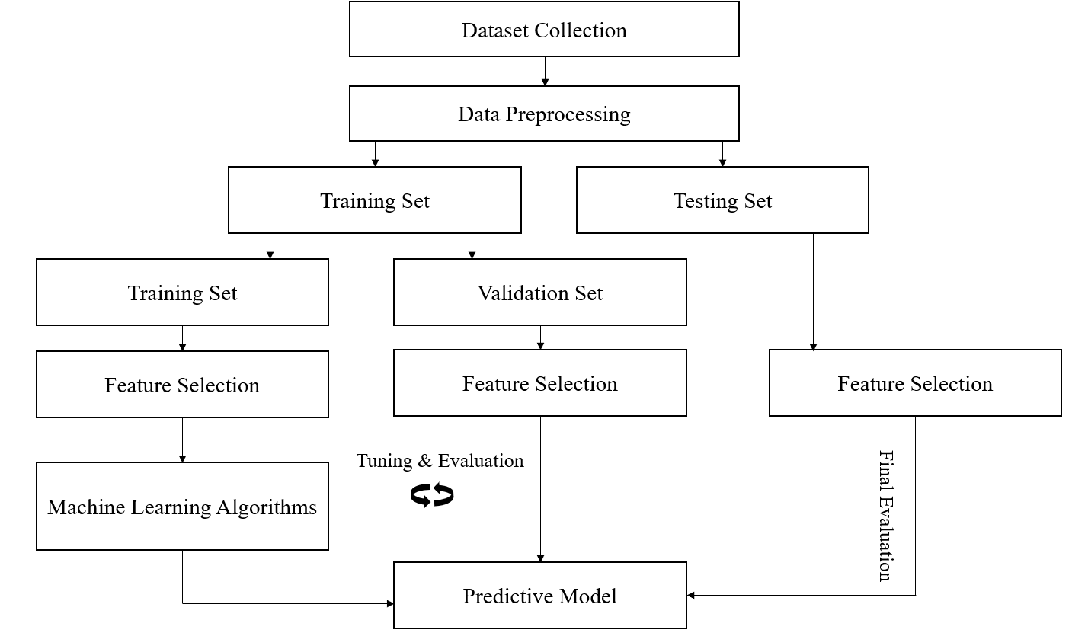
ARCHITECTURE DIAGRAM

Slide 18
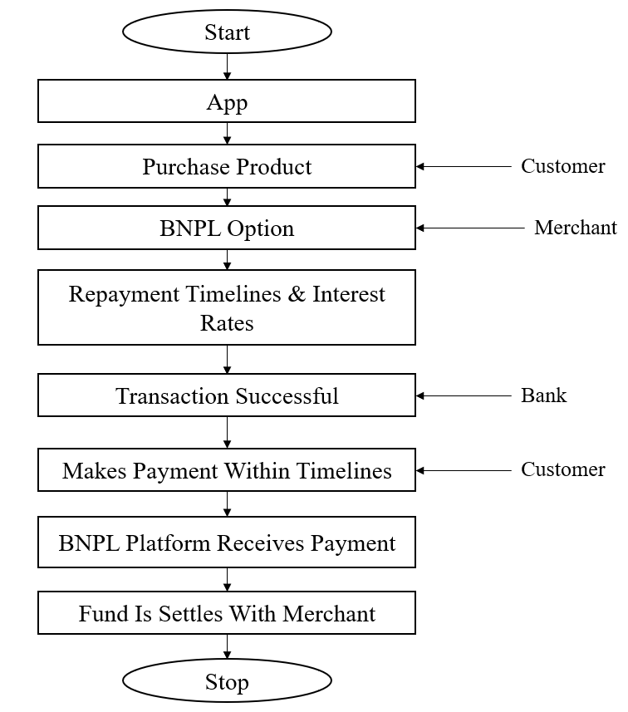
DATA FLOW DIAGRAM

Slide 19
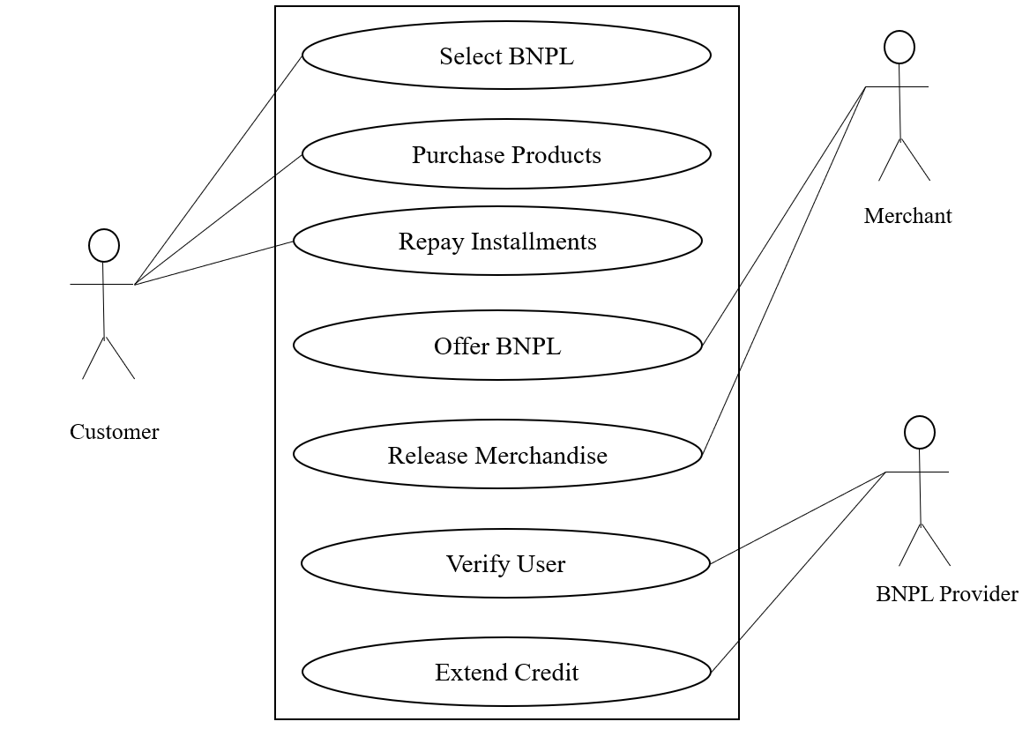
Use Case Diagram

Slide 20
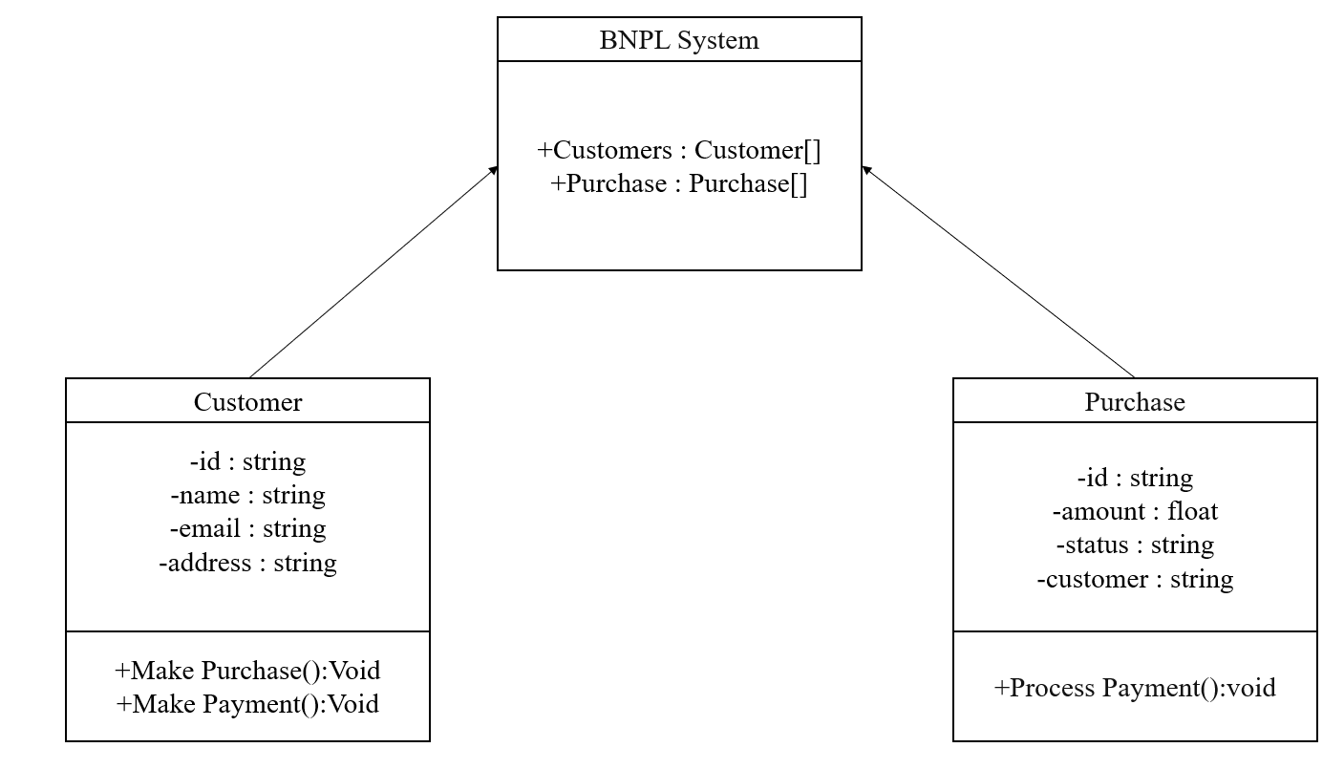
Class Diagram

Slide 21
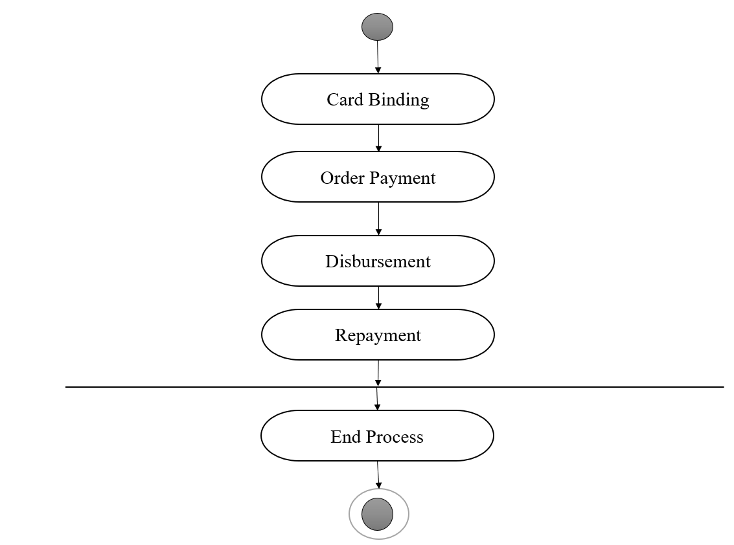
Activity Diagram

Slide 22
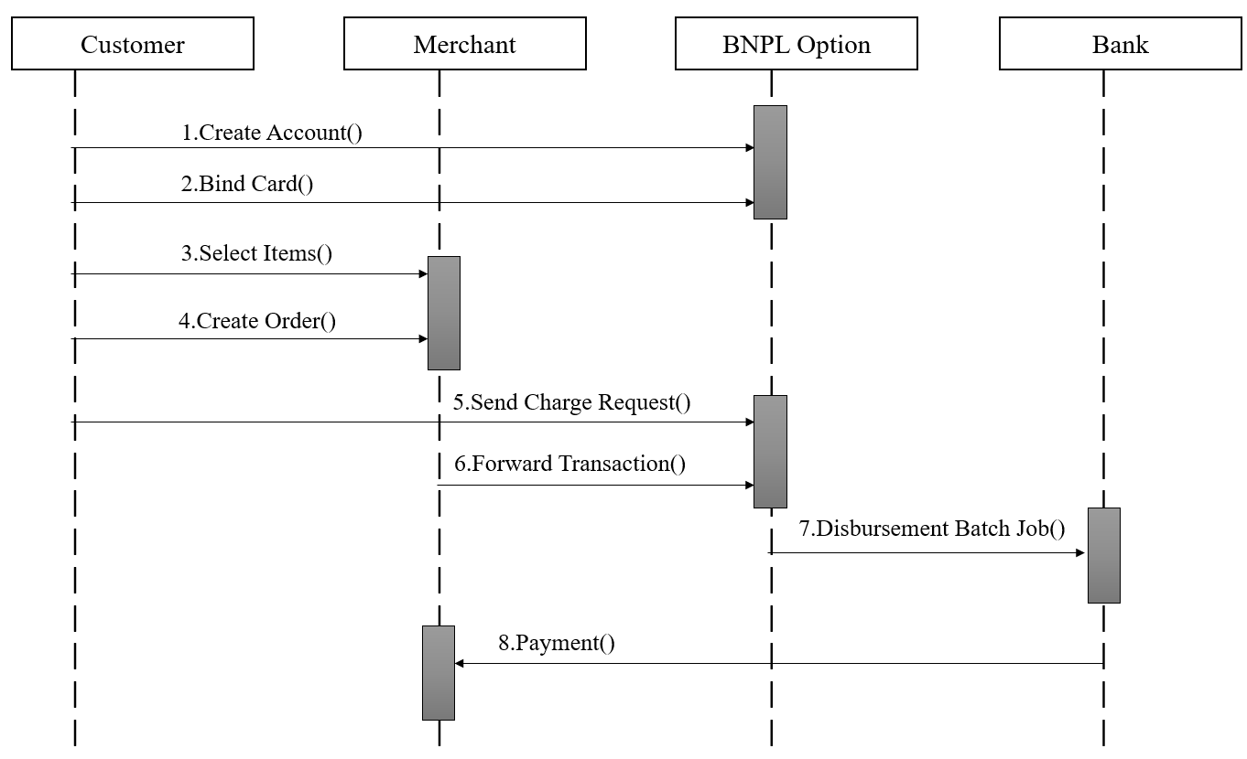
Sequence Diagram

Slide 23
TESTING
UNIT TESTING
INTEGRATION TESTING
FUNCTIONAL TESTING
WHITE BOX TESTING
BLACK BOX TESTING

Slide 24
UNIT TESTING
For a "Buy Now, Pay Later" (BNPL) system, unit testing entails examining each system component to make sure it operates as intended. Numerous situations, including varying payment frequency, interest rates, and boundary conditions, are covered by the tests. To maintain system dependability and find issues early in development, it’s essential to automate tests, make sure there is code coverage, and do regression testing.

Slide 25
INTEGRATION TESTING
The purpose of integration testing for a "Buy Now, Pay Later" (BNPL) system is to confirm that all of its parts payment gateways, credit checks, account management, inventory systems, communication channels, analytics tools, and security measures work together seamlessly. This testing ensures that consumers will have a dependable and secure BNPL experience by guaranteeing seamless integration.

Slide 26
FUNCTIONAL TESTING
Verifying the features and functions of a "Buy Now, Pay Later" (BNPL) system is the main goal of functional testing. It guarantees easy registration, product selection, BNPL transaction initiation, payment processing, and account management for users. Additionally, interfaces with payment gateways, credit checks, and communication channels are validated during this testing. Functional testing ensures that customers have a dependable and smooth BNPL experience by carefully evaluating the system's behavior.

Slide 27
WHITEBOX TESTING
In order to guarantee comprehensive test coverage, white-box testing for a "Buy Now, Pay Later" (BNPL) system entails analyzing its underlying structures, code pathways, and logic. This comprises boundary value testing to check inputs at their limits, path testing to cover all potential execution paths, integration testing to confirm data flow across modules, and unit testing of individual components. Other essential components include data flow, performance, security testing, and error management. Developers can guarantee the stability, dependability, and security of the BNPL system by utilizing these tactics.

Slide 28
BLACKBOX TESTING
Black-box testing for a "Buy Now, Pay Later" (BNPL) system utilizing machine learning focuses on evaluating the system's functionality, usability, performance, security, and data quality without requiring knowledge of its internal machine learning algorithms. This testing ensures that the BNPL system meets user requirements and performs reliably in real-world scenarios, without delving into the specifics of its underlying machine learning models.

Slide 29
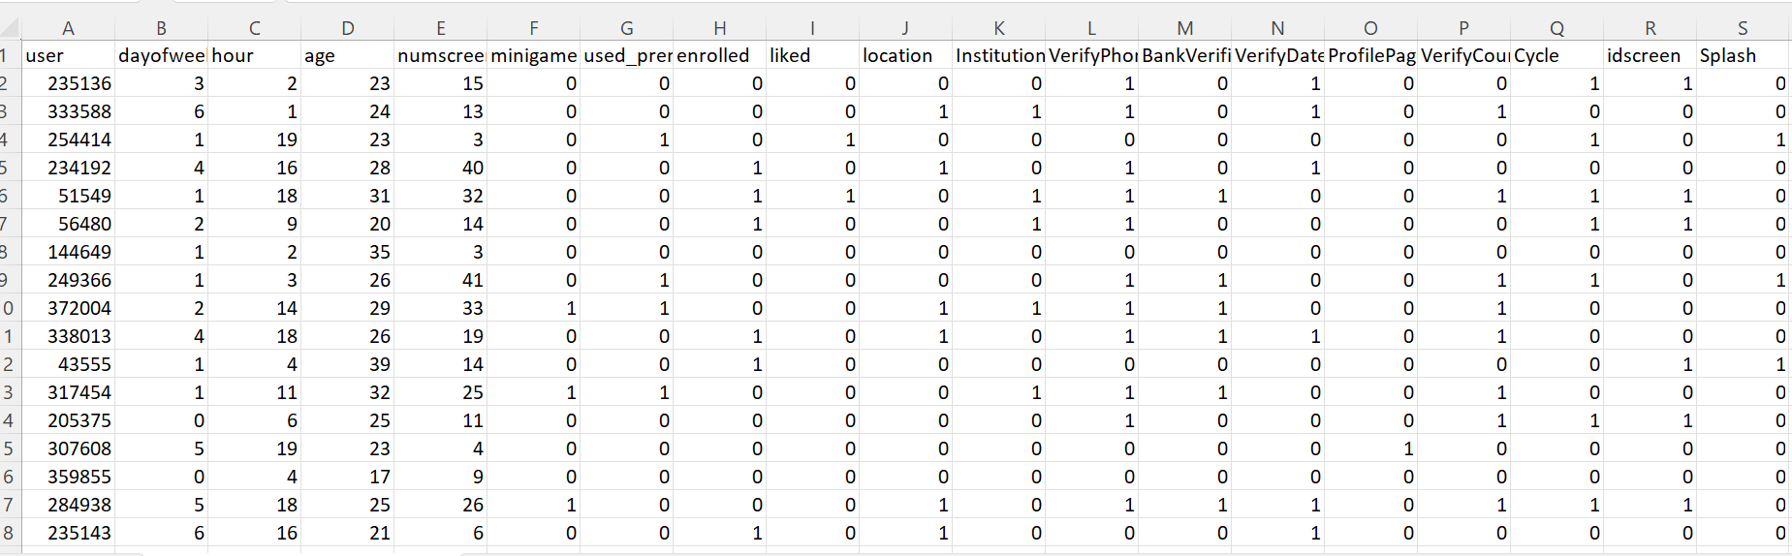
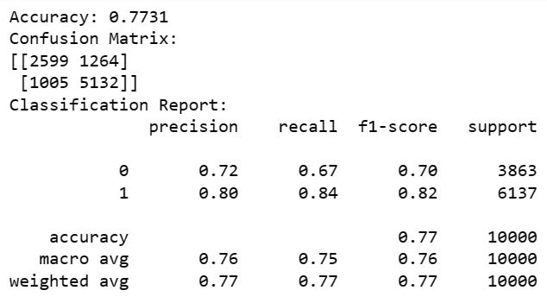
INPUT:
OUTPUT:

Slide 30
Conclusion
In conclusion, for customers who use "buy now, pay later" options properly, they can be advantageous. They provide ease of use, adaptability, and efficient cash flow management. Additionally, they can grant access to products and services that would otherwise be prohibitively expensive up front. Customers must, however, be aware of the terms and conditions of these services, including any fees, interest rates, and possible repercussions for missing payments. "Buy now, pay later" agreements can result in debt accumulation, financial hardship, and credit score harm if they are not managed carefully.

Slide 31
REFERENCES
[1] Chernovita, H.P., 2020, April. The Role of Financial Literacy to Suppress Temptation of Using Pay Later Service. In 2020 IEEE 10th Symposium on Computer Applications & Industrial Electronics (ISCAIE) (pp. 113-117). IEEE.
[2] Pareek, S. and Mittal, M., 2020, June. Non instantaneous deteriorating inventory model under credit financing when demand depends on promotion and selling price. In 2020 8th International Conference on Reliability, Infocom Technologies and Optimization (Trends and Future Directions)(ICRITO) (pp. 973-977). IEEE.
[3] Hasani, R. and Khoshalhan, F., 2020, December. A supply chain coordination mechanism with credit option contract considering backordered demand of customer. In 2011 IEEE International Conference on Industrial Engineering and Engineering Management (pp. 945-949). IEEE.
[4] Arisandy, Y.O.S.Y., Dasril, Y.B., Salahudin, S.N.B., Muslim, M.A., Adnan, A. and Wen, G.K., 2023 IEEE. Buy Now Pay Later Services on Generation Z: Exploratory Data Analysis Using Machine Learning. Journal of Theoretical and Applied Information Technology, 101(11), pp.4194-4204.
[5] Tounekti, O., Ruiz-Martínez, A. and Gómez, A.F.S., 2019. Users supporting multiple (mobile) electronic payment systems in online purchases: An empirical study of their payment transaction preferences. IEEE Access, 8, pp.735-766.

Slide 32
[6] Sanboon, T., Keatruangkamala, K. and Jaiyen, S., 2019, February. A deep learning model for predicting buy and sell recommendations in stock exchange of thailand using long short-term memory. In 2019 IEEE 4th International Conference on Computer and Communication Systems (ICCCS) (pp. 757-760). IEEE.
[7] Lupsa-Tataru, D.A., Nichifor, E., Dovleac, L., Chițu, I.B., Todor, R.D. and Brătucu, G., 2023 IEEE. Buy Now Pay Later—A Fad or a Reality? A Perspective on Electronic Commerce. Economies, 11(8), p.218.
[8] TAS, C., 2023 IEEE. Comparison of Machine Learning and Standard Credit Risk Models' Performances in Credit Risk Scoring of Buy Now Pay Later Customers (Master's thesis, Middle East Technical University).
[9] Di Maggio, M., Williams, E. and Katz, J., 2022 IEEE. Buy now, pay later credit: User characteristics and effects on spending patterns (No. w30508). National Bureau of Economic Research.
[10] Guttman-Kenney, B., Firth, C. and Gathergood, J., 2023 IEEE. Buy now, pay later (BNPL)... on your credit card. Journal of Behavioral and Experimental Finance, 37, p.100788.

Slide 33
THANK YOU

